Slide 1

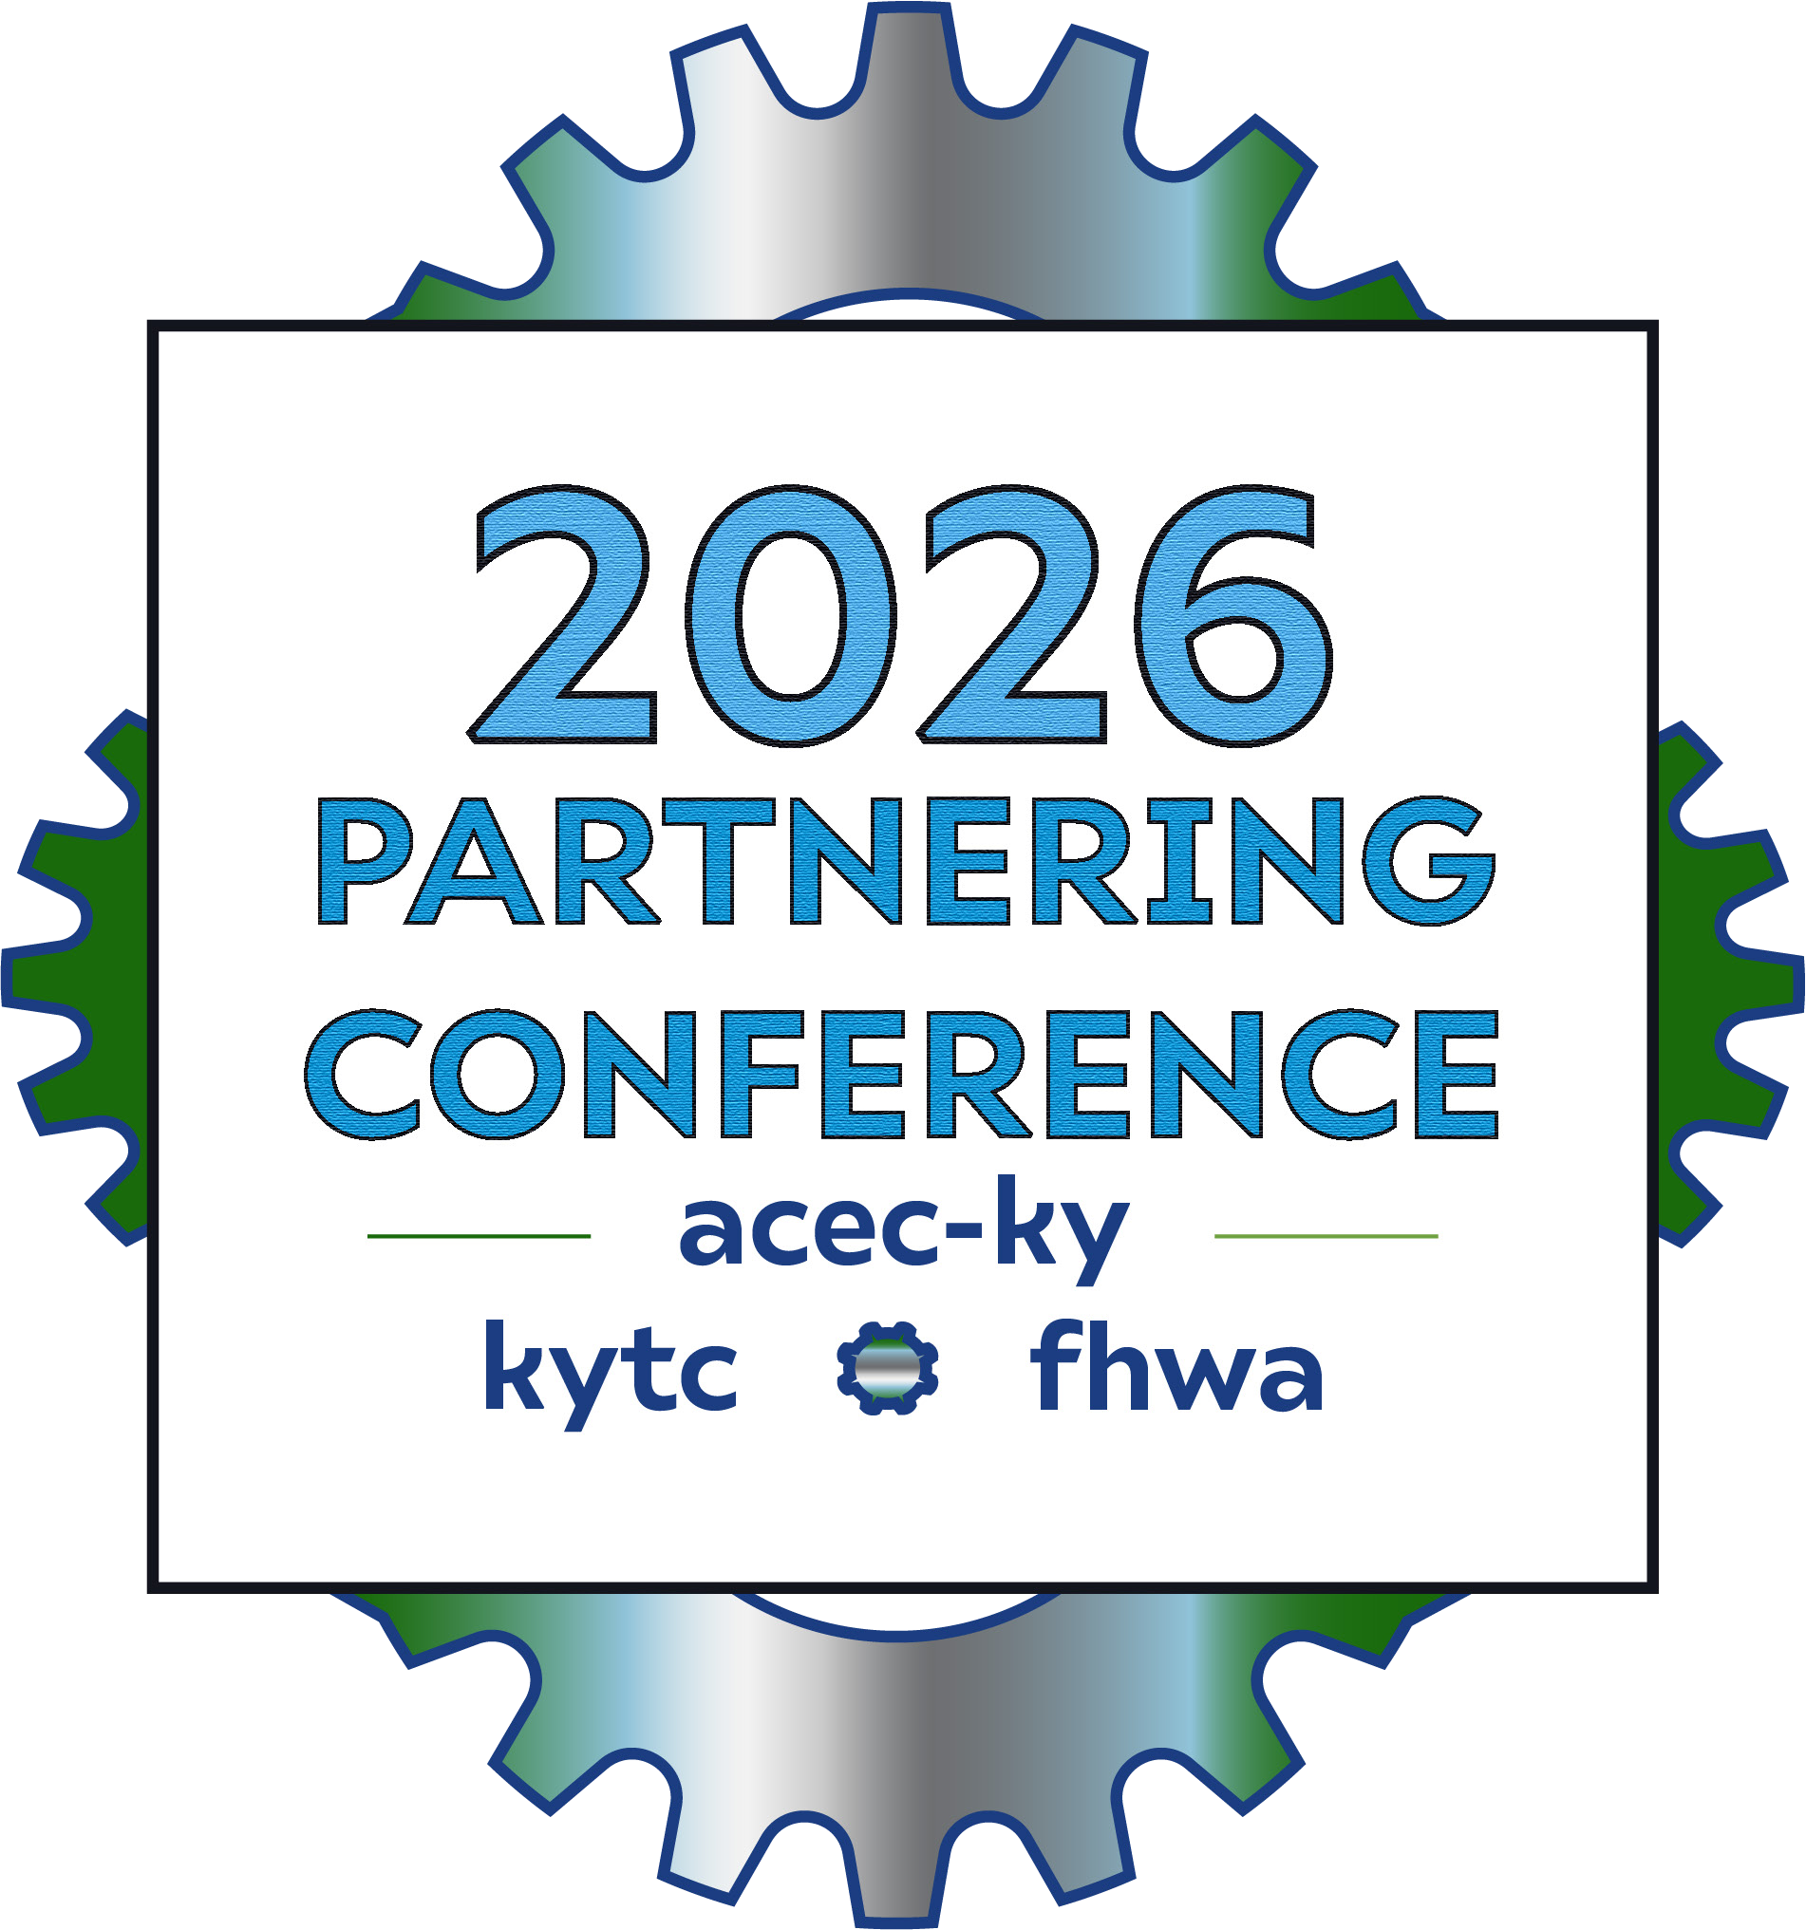
Just a Little Bridge Project
With A LOT of Coordination
Andrew Logsdon – KYTC DEA
Chris James – KYTC District 12
Jason Littleton – WSP

Slide 2
What is a 408 permit and do I need one?
The Section 408 program verifies that changes to authorized USACE Civil Works projects will not be injurious to the public interest and will not impair the usefulness of the project. This requirement was established in Section 14 of the Rivers and Harbors Act of 1899, which has since been amended several times, and is codified at 33 U.S.C. 408–the section of U.S. Code that gives the program its name……. HUH??
The U.S. Army Corps of Engineers Section 408 program provides permission for people, towns, or businesses to alter or impact a USACE project, like a dam, levee, floodwall or waterway. Before any changes can be made, the Section 408 program reviews alterations to ensure they won’t harm the project or the public.

Slide 3


Examples of 408 activities
Building a bridge across a navigable waterway.
Building docks in or near a navigation channel.
Building a new structure or altering an existing structure within a levee’s easement.
Raising a levee.
Building a new road and bridge to a serve a new high school in eastern KY. (hold up, what?)

Slide 4


Where are the 408 resources in KY?
There are a variety of places to look to determine if your project needs to consider the 408 permit process. First check your local USACE district website to see if they have a map; the National Levee Database; the National Inventory of Dams; or even your local property appraiser’s website or tax assessor’s office. You can also contact the district’s Section 408 Coordinator. Sometimes it will make sense to check in multiple locations to make sure you’re not missing a 408 resource.
District 10 had one we weren’t aware of until late in the game on the KY 15 project in Panbowl Lake
https://www.arcgis.com/home/item.html?id=632a401d304d4eebbce208d703aa01ab#overview

Slide 5

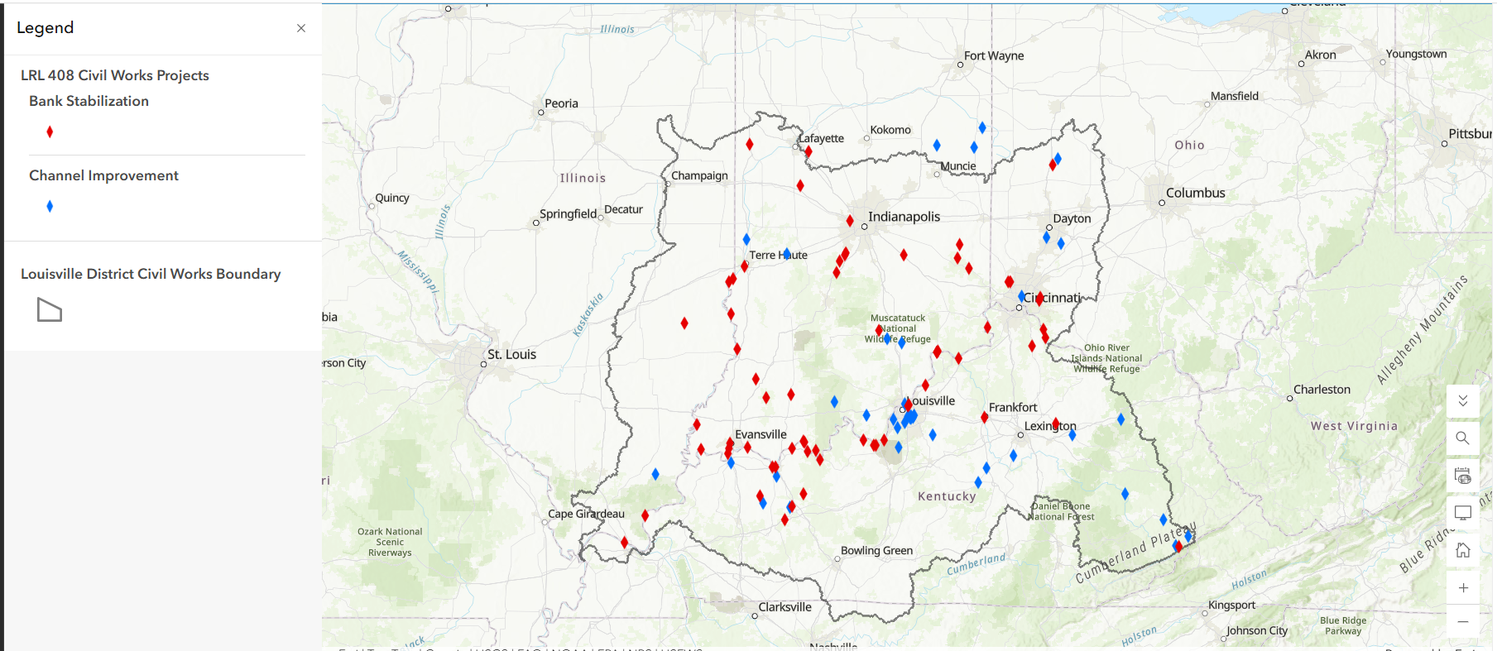
Louisville Corps District Map of
Section 408 Civil Works Projects

Slide 6

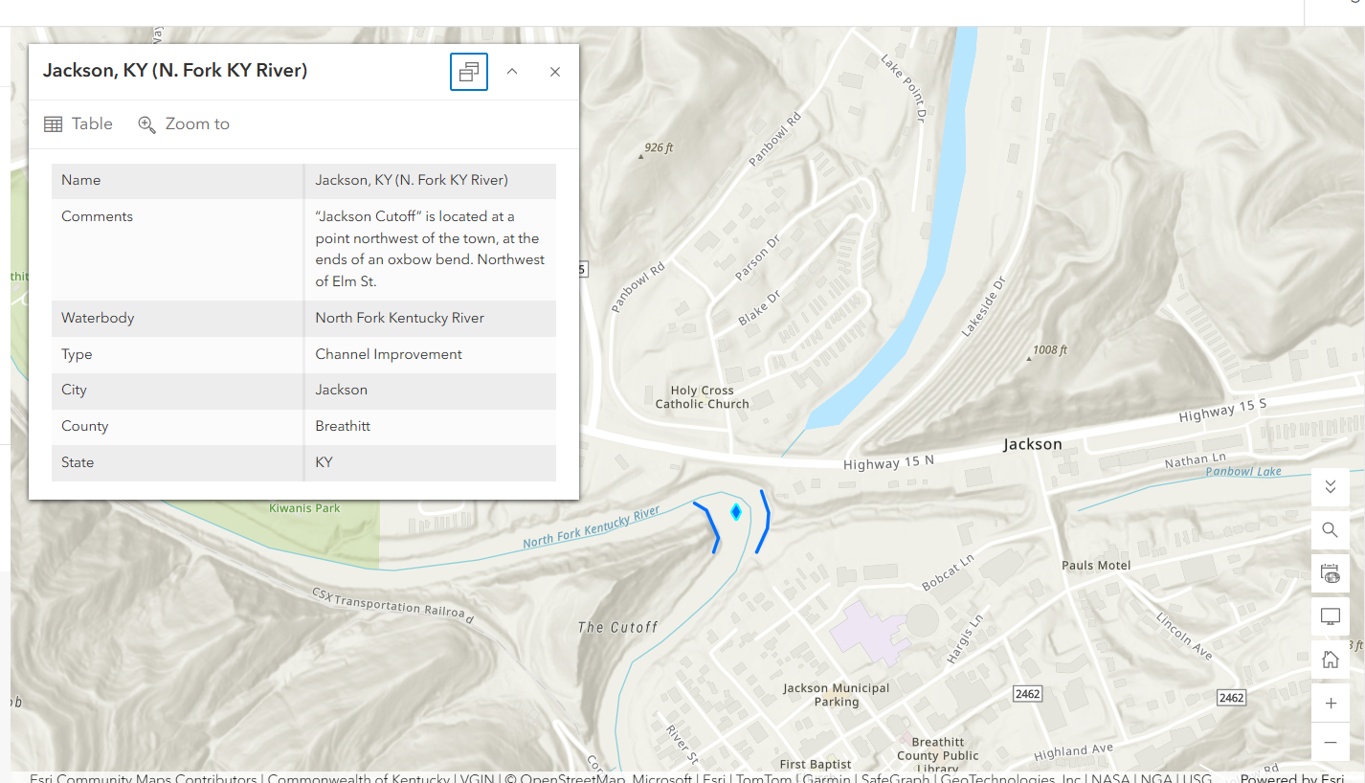


Slide 7

It looks like I may have a 408 project nearby, who do I contact?
What is a non-federal sponsor? They are a local or state agency responsible for the operations and maintenance of a USACE project. Typical non-federal sponsors include a local government, levee board, port authority, or a state government.
Section 408 Coordinator: Every USACE district has a Section 408 Coordinator. This person reviews any alterations your proposal makes to a USACE project. They are there to help guide you. KYTC has worked mostly with Brandon Adair and Andrew Brooks at the Louisville Corps.

Slide 8
What are the next steps?
Identify and connect with your non-federal sponsor. Contact your non-federal sponsor and explain your alteration to them. In order to proceed with your request, you will need a Statement of No Objection (SONO) from the non-federal sponsor documenting their awareness of the request and their lack of objection to USACE reviewing it.
Contact your USACE district and consider a pre-application meeting. Once you have firmed up the design for your 408 permission request, consider a pre-application meeting with your Section 408 Coordinator and the nonfederal sponsor. Pre-application meetings help you get feedback on your design, ask questions, establish communication, build relationships, and align your schedule with your Section 408 Coordinator. Pre-application meetings are not required but can be helpful to establish a rapport and relay urgency.

Slide 9
What if I need other Corps permits?
Section 408 requests often involve work in navigable waters or result in discharge of dredged and fill material into waterways which requires a 404 permit.
It’s your responsibility to submit your application to Regulatory in addition to your 408 request. Your district’s Section 408 Coordinator works closely with Regulatory staff to ensure that Section 408 and Regulatory requirements are both met. If you don’t seek both authorizations, your request may be delayed.
YOU WILL NOT GET YOUR 404 APPROVED UNTIL YOUR 408 HAS BEEN ISSUED.

Slide 10
12-80250 Project Overview
Accessing new Johnson Co Schools campus from KY 40
Crossing Paint Creek
Between Tractor Supply & Judicial Center
KY 40
Johnson County Judicial Center
720 ft
Paint Creek
Tractor Supply
New JCPS Property

Slide 11
12-80250 Project Site
Accessing new Johnson Co Schools campus
Crossing Paint Creek
Between Tractor Supply & Judicial Center
USACE Floodproofing Project
KY 40
Johnson County Judicial Center
Paint Creek
Tractor Supply

Slide 12
Project Coordination
Johnson County Schools (and their engineer-Bocook Engineering)
USACE – hydraulics relating to Section 202 Floodproofing Project
Johnson County – Judicial Center parcel impacted
Paintsville City Utilities – Water, Sewer, and Gas facilities
Private Property Owners – Tractor Supply Company

Slide 13
Step 1: Get on the same page...
12-80250
On July 28, 2025, Brett Latta from USACE emailed to coordinate about KYTC's project
Interested in how 12-149 was going to impact the USACE Floodproofing project
He asked for a coordination meeting...about 12-149
12-149
USACE Floodproofing Project
"Five minutes of communication can save a year's worth of turmoil and misunderstanding." - Joyce Meyer

Slide 14
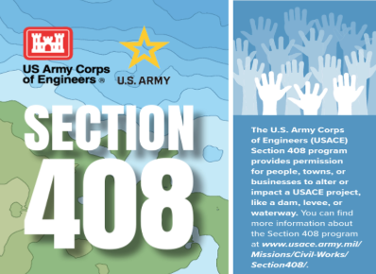
Step 2: Face the Facts
August 1, 2025: During a coordination meeting with Johnson County officials and USACE representatives regarding 12-149, we were told about the permitting requirements for 12-80250
"Facts are hard things – and either we deal with the facts, or the facts will deal with us." - Gary A. Haugen

Slide 15
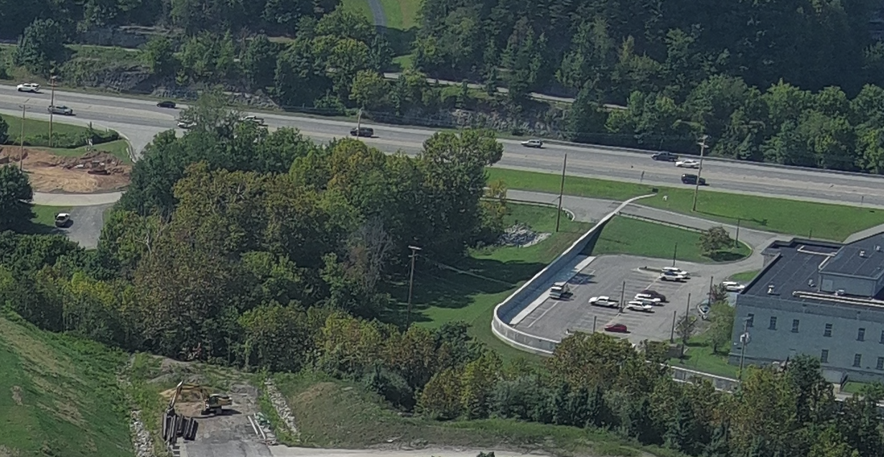
Step 3: Lay your cards on the table
August 14, 2025: First meeting between USACE and KYTC regarding 12-80250
August 25, 2025: Field visit to project site with USACE, KYTC, and Johnson County officials
"You've got to know when to hold 'em, Know when to fold 'em
Know when to walk away, And know when to run" – Kenny Rogers "The Gambler"

Slide 16
12-80250 Project Site
Channel Change
Gravity Sanitary
270’ Bridge
Sanitary Force Main

Slide 17
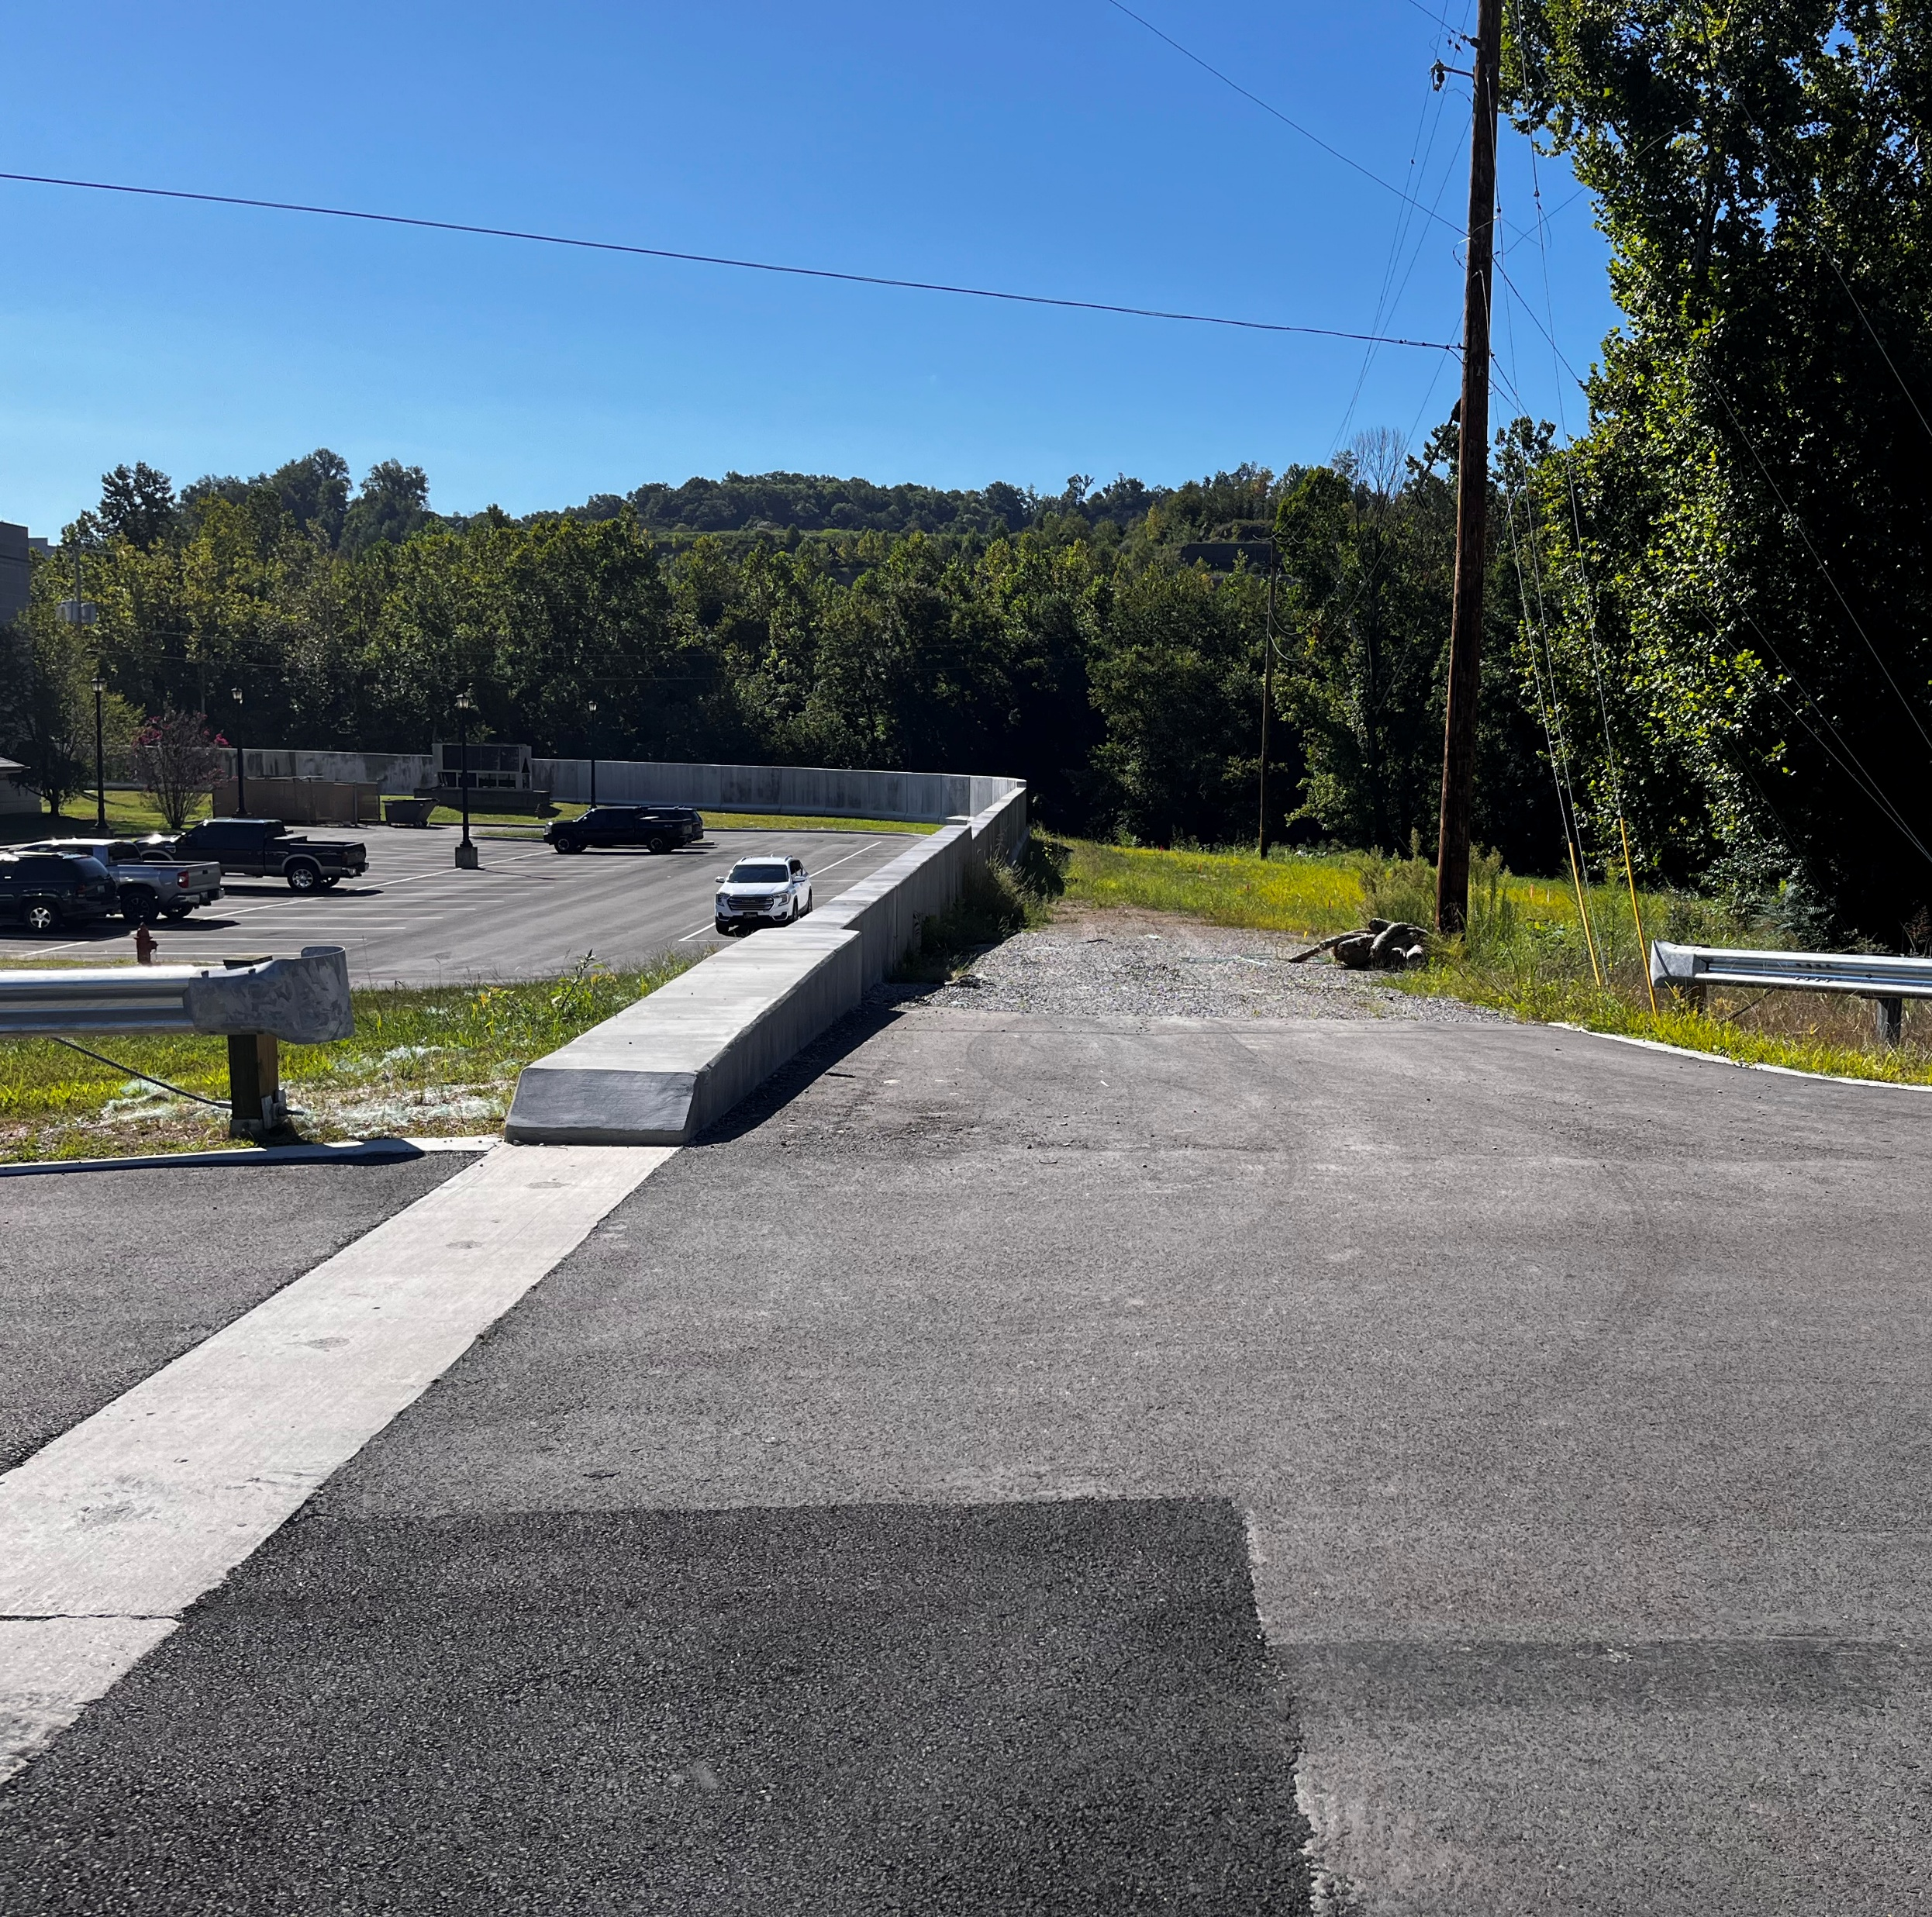
§408 – Johnson County Site Visit
Brand new floodwall
USACE Design/Construction Concerns
Construction Access/Laydown
Sanitary Sewer Relocation
Sanitary Sewer Force Main Installation
Channel Change slope protection

Slide 18
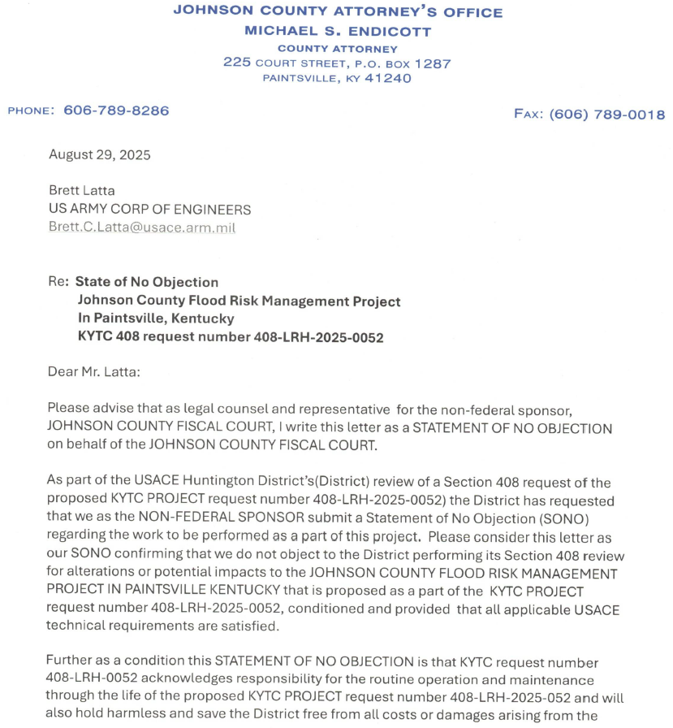
Step 4: How do we start?
No official "form" to submit the request for a formal Section 408 review
Basic information about the project (location, map, the Section of the Federally authorized civil works project that would be impacted)
A Statement of No Objection (SONO) from the local Non-Federal Sponsor is required
Johnson County officials submitted the SONO on September 4, 2025
"The way to get started is to quit talking and begin doing." — Walt Disney

Slide 19
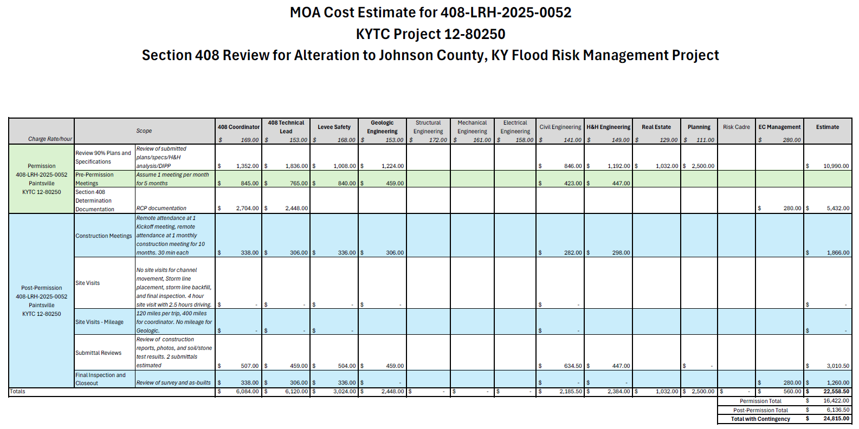
Step 5: What's this gonna cost?
September 2, 2025: USACE provided initial estimate of review costs
This is broken into two parts:
  Permission (obtaining the 408 permit)
  Post-permission (construction oversight)
Funding agreement is voluntary
"For which of you, desiring to build a tower, does not first sit down and count the cost, whether he has enough to complete it?" - Jesus

Slide 20
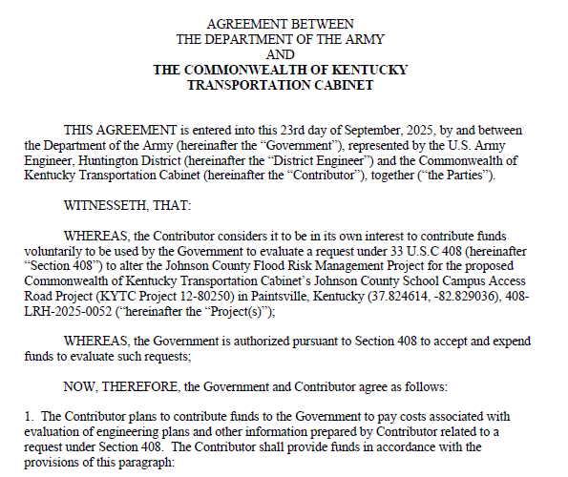
Step 6: An MOA with the USA
USACE developed a draft MOA for KYTC to review
KYTC would agree to contribute funds voluntarily
Required the approval of KYTC leadership
Required coordination between USACE and KYTC (especially for the approved funding amount)
"Good discourse sinks differences and seeks agreements." - Amos Bronson Alcott

Slide 21
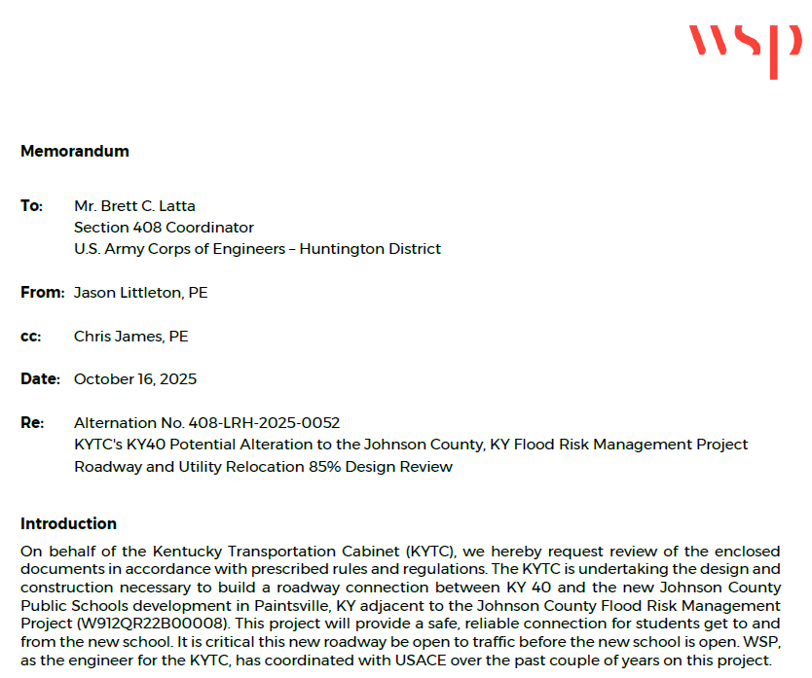
Step 7: Submit the submittal
After initial meeting and field visit, KYTC worked with WSP to craft the Section 408 submittal
This required additional meetings/coordination with USACE
October 28, 2025: "Final" submittal to USACE
"You never know what you can do till you try." — William Cobbett

Slide 22
§408 Submittal
Focus on & address concerns in written request for review
Supporting documentation in “enclosures”
Encl.
1. Statement Of No Objection from Non-Federal Sponsor
2. Draft Section 408 Contributed Funds Agreement, dated September 23, 2025
3. Environmental Clearances and Programmatic Agreements
4. Bridge Geotechnical Report
5. 85% Design Roadway Construction Drawings
6. KYTC Standard Specifications for Road and Bridge Construction, 2019 Edition with Supplemental Specifications effective August 2024 construction letting
7. Project Hydraulic Analysis (HEC-RAS)
8. 85% Design Sanitary Sewer Relocation Drawings
9. Paintsville Utilities Wastewater Specifications for Engineers and Developers
10. Johnson County Flood Risk Management Project (W912QR22B00008) cross sections with superimposed zone of influence, channel improvements and utility improvements

Slide 23
Step 8: It's Kickoff Time!
The "official" Section 408 kickoff meeting was held November 20, 2025
This gave KYTC the opportunity to walk the USACE folks through the submittal
Discussed more details about the project, approximate schedule, and impacts
"Start where you are. Use what you have. Do what you can." - Arthur Ashe

Slide 24
Step 9: Back to the MOA
The USACE cost estimate changed from the initial submittal
The new estimate assumed more cost for post-permission review during construction
Required additional approval of KYTC leadership
The Final MOA was signed December 11, 2025
"When you are through changing, you are through." - Bruce Barton

Slide 25
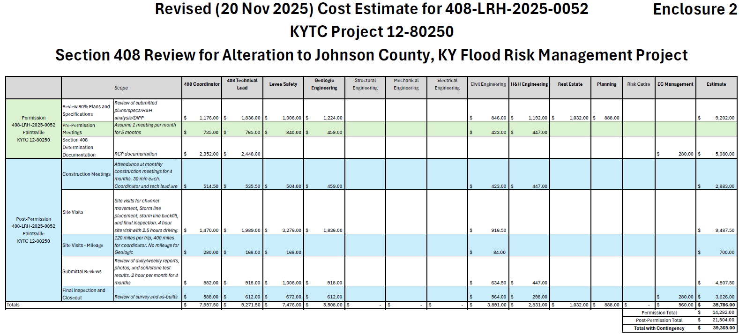
Step 10: Money Matters
The pre-permission and post-permission review total was $39,365
USACE "can't charge/bill for work that hasn't been performed yet"
USACE "can't work on reviews without funds"
The entire funding amount was transferred to USACE on January 7, 2026
"Never spend your money before you have earned it." - Thomas Jefferson

Slide 26
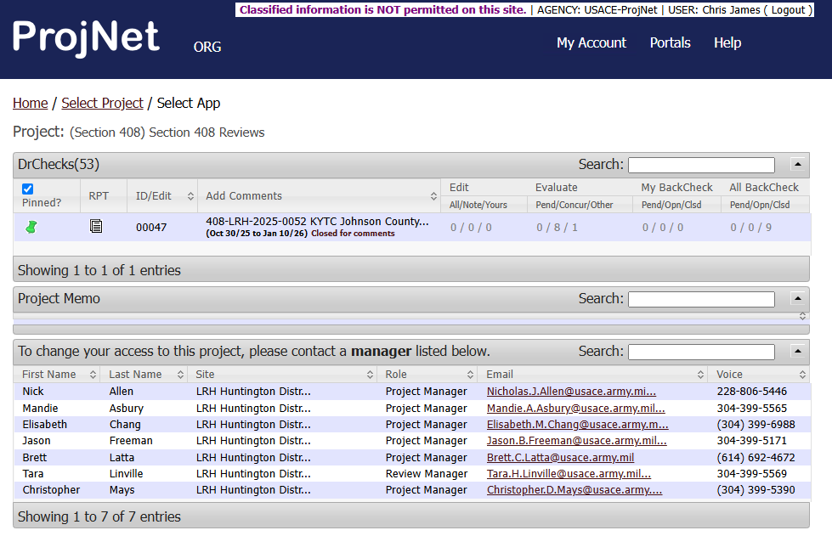
Step 11: Visit the Dr(Checks)
Submittal review comments were handled through an online software program called DrChecks
USACE Subject Matter Experts made comments about various issues (geotechnical, environmental, construction specs, etc.)
KYTC answered questions, provided additional information, and addressed changes in DrChecks
"Isn't it a bit unnerving that doctors call what they do "practice"?" - George Carlin

Slide 27
§408 Design Changes
Construction Access Restrictions

Slide 28
§408 Design Changes
Gravity Sanitary Sewer

Slide 29
§408 Design Changes
Gravity Sanitary Sewer

Slide 30
§408 Design Changes
Gravity Sanitary Sewer

Slide 31
§408 Design Changes
Channel Change Protection

Slide 32
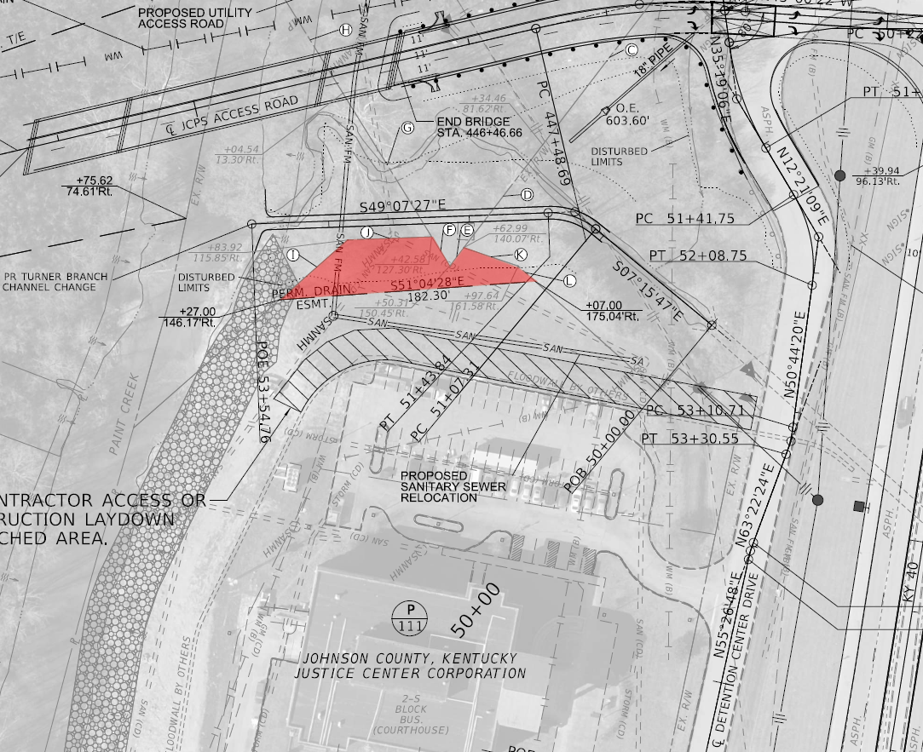
Step 12: Work out R/W Issues
The Non-Federal Sponsor, Johnson County, had to be satisfied with the R/W impacts
The rights of the Non-Federal Sponsor could not be superseded by KYTC
KYTC modified the R/W plans to show a permanent easement, with specific language in the deed to satisfy these requirements
"The most important trip you may take in life is meeting people halfway." - Henry Boyle

Slide 33
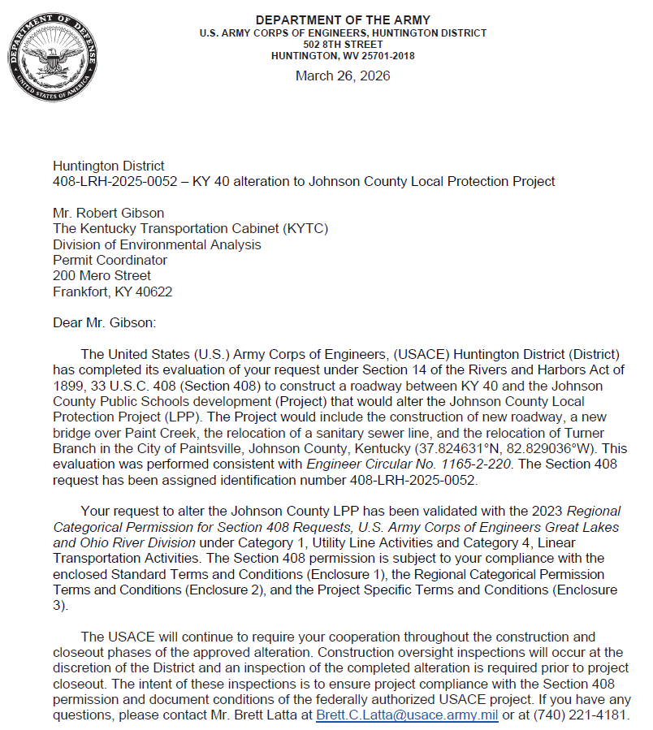
Step 13: Final Coordination
After changes were made to the satisfaction of reviewers, USACE sent Draft Terms and Conditions
The "Completeness Letter" was received from USACE on February 27, 2026
KYTC received the Section 408 permit on April 8, 2026
Let to construction May 27, 2026
"Well done is better than well said." - Benjamin Franklin

Slide 34
